Slide 1
Chapter 3: Patient preparation and basic IUS techniques
v1.0, 10 December 2022 | EM-121011
For Healthcare Professionals only
Developed under the mentorship of the Asian Organization for Crohn's & Colitis
Supported by Janssen Asia Pacific, a division of Johnson and Johnson International (Singapore) Pte. Ltd. Editorial development by Transform Medical Communications, New Zealand
© Janssen Asia Pacific, a division of Johnson & Johnson International (Singapore) Pte. Ltd.

Slide 2
About IUS Primer module
IUS Primer module was created for training gastroenterologists in Asia on adopting Intestinal Ultrasound (IUS) for the diagnosis and management of Inflammatory Bowel Disease
Transform Medical Communications was commissioned by Janssen Asia Pacific for the development of this educational module under the guidance of IUS Primer working group members and AOCC. The division of Janssen responsible for developing the module is from medical education that follows strict non-promotional and educational guidance.
The development of the module was funded by Janssen Asia Pacific, a division of Johnson and Johnson Pte. Ltd in 2022. Non-commercial use of this module is permitted without any further permission, provided credit for the content is clearly attributed to Janssen Asia Pacific.
AOCC: Asian Organization for Crohn's & Colitis; IUS: Intestinal ultrasound.

Slide 3
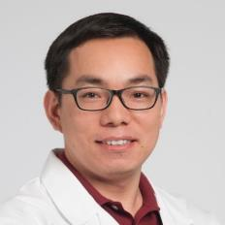
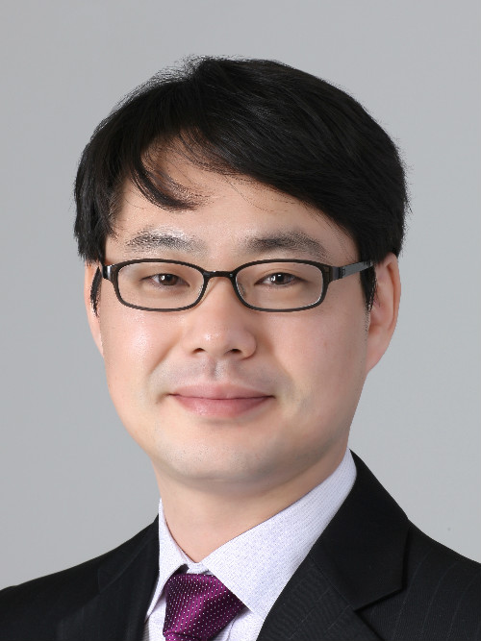
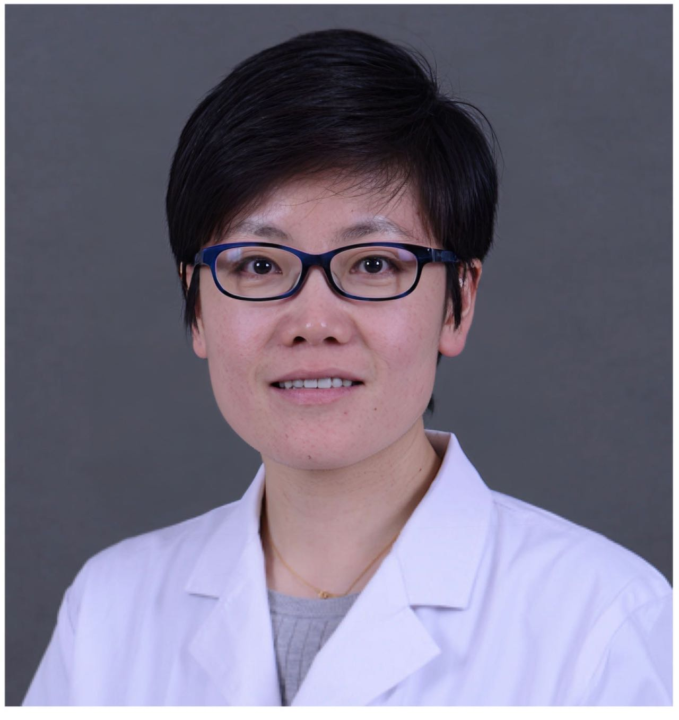
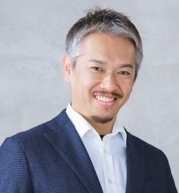
Special thanks to IUS Primer AOCC working group members
Prof. Eun Soo Kim
A/Prof. Ren Mao
Kyungpook National University
First Affiliated Hospital of Sun Yat-sen University
KOREA
CHINA
Prof. Chang Kyun Lee
A/Prof. Jun Miyoshi
Kyung Hee University
Kyorin University
KOREA
JAPAN
Prof. Yue Li
Dr. Shintaro Sagami
Peking Union Medical College Hospital
Kitasato University Kitasato Institute Hospital
CHINA
JAPAN
AOCC: Asian Organization for Crohn's & Colitis; IUS: Intestinal ultrasound; WG: working group.

Slide 4
Learning Objectives
Understand the patient preparation and position for the IUS examination
Learn the basic IUS techniques for adults and children
Explore the types of probes and steps for conducting an IUS examination
1
2
3

Slide 5
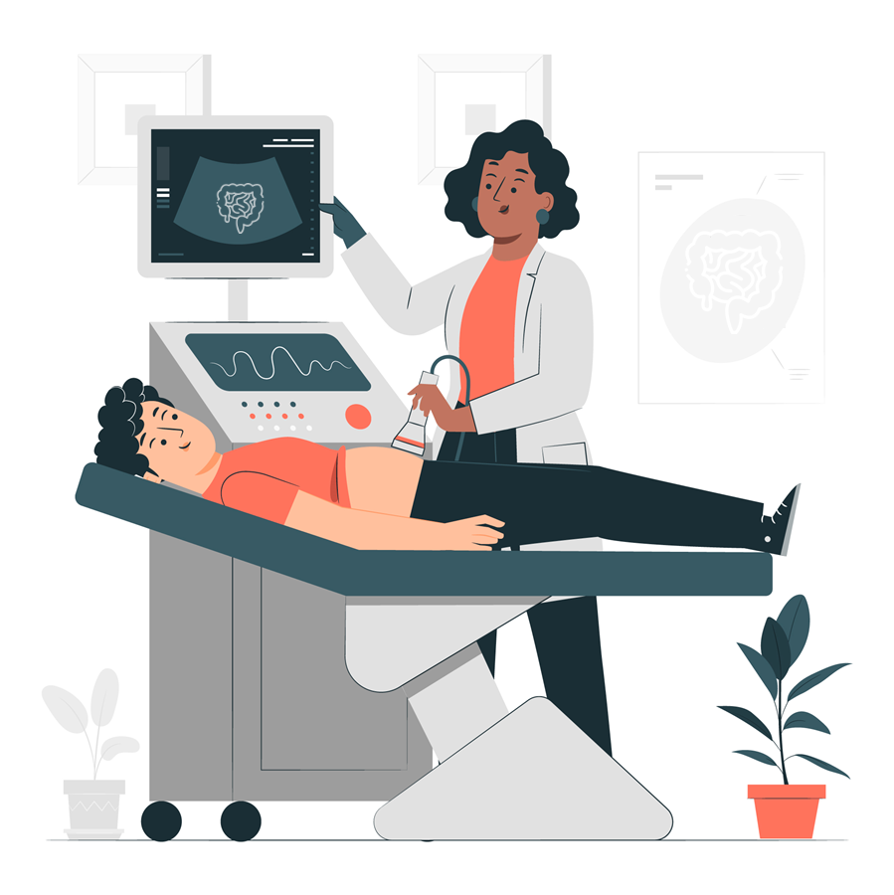
Ideal conditions for IUS examination
The technique
The probe is held in contact with the patient’s skin to gauge pressure with one hand, whilst the other hand is free to optimize image parameters on the machine.
The position
The patient must be relaxed, and comfortable in a supine position to avoid the tension of the abdominal wall.
The environment
Ideally, the patient is placed in a dedicated consulting space with low light sources to facilitate patient comfort.
Body illustration vector redesigned using image from Freepik.com: https://www.freepik.com/vectors/body-illustration
IUS: intestinal ultrasound.
Atkinson, N. (2017). World journal of gastroenterology, 23(38), 6931–6941.
Notes:
Atkinson, N., Bryant, R. V., Dong, Y., Maaser, C., Kucharzik, T., Maconi, G., Asthana, A. K., Blaivas, M., Goudie, A., Gilja, O. H., Nuernberg, D., Schreiber-Dietrich, D., & Dietrich, C. F. (2017). How to perform gastrointestinal ultrasound: Anatomy and normal findings. World journal of gastroenterology, 23(38), 6931–6941. https://doi.org/10.3748/wjg.v23.i38.6931
Image credit: https://www.freepik.com/free-vector/sonography-concept-illustration_25325931.htm#query=sonography&position=6&from_view=search
Freepik license allows to use the content
For commercial and personal projects
On digital or printed media
For an unlimited number of times and without any time limits
From anywhere in the world
To make modifications and create derivative works

Slide 6
Patient preparation for IUS examination
There is no specific patient preparation for a standard examination.^{1,2}
No need for fasting or bowel preparation for most IUS scans.^{1,2}
Laxatives, rectal water enema, and spasmolytic agents are not recommended.³
IUS: intestinal ultrasound
1. Bots, S., et al. (2022). Journal of Crohn's and Colitis, 16(4), 606-615.; 2. Asthana, A. K., et al. (2015). Journal of Gastroenterology and Hepatology, 30(3), 446-452; 3. Taylor, S. (2017). European radiology, 27(6), 2570–2582.
Notes:
1. Taylor, S. A., Avni, F., Cronin, C. G., Hoeffel, C., Kim, S. H., Laghi, A., Napolitano, M., Petit, P., Rimola, J., Tolan, D. J., Torkzad, M. R., Zappa, M., Bhatnagar, G., Puylaert, C., & Stoker, J. (2017). The first joint ESGAR/ ESPR consensus statement on the technical performance of cross-sectional small bowel and colonic imaging. European radiology, 27(6), 2570–2582. https://doi.org/10.1007/s00330-016-4615-9
2. Nylund, K., Maconi, G., Hollerweger, A., Ripolles, T., Pallotta, N., Higginson, A., Serra, C., Dietrich, C. F., Sporea, I., Saftoiu, A., Dirks, K., Hausken, T., Calabrese, E., Romanini, L., Maaser, C., Nuernberg, D., & Gilja, O. H. (2017). EFSUMB Recommendations and Guidelines for Gastrointestinal Ultrasound. EFSUMB-Empfehlungen und Leitlinien des Gastrointestinalen Ultraschalls - Teil 1: Untersuchungstechniken und Normalbefund (Langversion). Ultraschall in der Medizin (Stuttgart, Germany : 1980), 38(3), e1–e15. https://doi.org/10.1055/s-0042-115853
Bots, S., et al. (2022). Journal of Crohn's and Colitis, 16(4), 606-615.
Asthana, A. K., et al. (2015). Journal of Gastroenterology and Hepatology, 30(3), 446-452.

Slide 7
Patient preparation for doppler and I.V. contrast
Doppler
IV Contrast (used mainly for research purposes)¹
Routine use of color doppler is recommended.¹
After administration of sulphur hexafluoride IV contrast, scan between 10-40 seconds.
The optimal doppler flow setting is between 5-7 cm/s.^{2*}
If a contrast agent is given: the standard number of sulphur hexafluoride boluses is one, and the optimal dose is between 2.4 ml and 4.8 ml.
It is recommended that peak enhancement after contrast injection is measured.
Routine use of I.V. contrast agents, perfusion or time-intensity curves are not recommended.
*Based on common practice in Asia, also followed in the cited clinical study²
I.V.: intravenous
1. Taylor, S. (2017). European radiology, 27(6), 2570–2582. 2. Maaser, C. (2020). Gut. 69(9), 1629–1636
Notes:
1. Taylor, S. A., Avni, F., Cronin, C. G., Hoeffel, C., Kim, S. H., Laghi, A., Napolitano, M., Petit, P., Rimola, J., Tolan, D. J., Torkzad, M. R., Zappa, M., Bhatnagar, G., Puylaert, C., & Stoker, J. (2017). The first joint ESGAR/ ESPR consensus statement on the technical performance of cross-sectional small bowel and colonic imaging. European radiology, 27(6), 2570–2582. https://doi.org/10.1007/s00330-016-4615-9

Slide 8
Specific considerations for pediatric patients
Use of laxatives, rectal water enema, spasmolytics, or I.V IUS contrast is not recommended.
A full scan of the abdominal and pelvic area is recommended, including the liver.
Younger children do not tolerate prolonged food and fluid restrictions before IUS examination, hence recommendations are made according to the age of the patient, based on expert opinions.
Consumption of still water and non-carbonated fruit juice is recommended.
IUS: intestinal ultrasound; I.V.: intravenous
Taylor, S. (2017). European radiology, 27(6), 2570–2582.
Notes:
1. Taylor, S. A., Avni, F., Cronin, C. G., Hoeffel, C., Kim, S. H., Laghi, A., Napolitano, M., Petit, P., Rimola, J., Tolan, D. J., Torkzad, M. R., Zappa, M., Bhatnagar, G., Puylaert, C., & Stoker, J. (2017). The first joint ESGAR/ ESPR consensus statement on the technical performance of cross-sectional small bowel and colonic imaging. European radiology, 27(6), 2570–2582. https://doi.org/10.1007/s00330-016-4615-9

Slide 9
Choice of probes (transducers) for the IUS examination
Types of probes used for IUS¹:
Low-frequency convex probe: Used to scan the abdomen, visualise deeper structures and detect grossly abnormal pathologies.
High-frequency linear probe: Used for a detailed evaluation of the intestinal wall.
01
Probe Frequency
Both ‘mid to high’ and ‘low’ frequency probes are recommended for a complete evaluation.^{2, 3}
Since the thickness of the bowel wall layers usually is less than 1mm, the frequency of a probe must be at least 5 megahertz (MHz) for wall layers to be well discriminated.³
02
Frequency Range
The resolution of a mid-frequency range transducer (5 – 10MHz) is quite adequate for separating individual layers in the GI wall.³
A low-frequency range transducer (1 – 6MHz) is also needed for a general overview and deeper-lying bowel segments, such as the rectum or in obese patients.³
IUS: intestinal ultrasound; I.V.: intravenous
1. Andrzejewska, M., & Grzymisławski, M. (2018). Gastroenterology Review. 13(1), 1-5. 2. Taylor, S. (2017). European radiology, 27(6), 2570–2582. 3. Nylund, K. (2017). Ultraschall in der Medizin (Stuttgart, Germany : 1980), 38(3), e1–e15.
Notes:
1. Andrzejewska, M., & Grzymisławski, M. (2018). Gastroenterology Review. 13(1), 1-5.
1. Taylor, S. A., Avni, F., Cronin, C. G., Hoeffel, C., Kim, S. H., Laghi, A., Napolitano, M., Petit, P., Rimola, J., Tolan, D. J., Torkzad, M. R., Zappa, M., Bhatnagar, G., Puylaert, C., & Stoker, J. (2017). The first joint ESGAR/ ESPR consensus statement on the technical performance of cross-sectional small bowel and colonic imaging. European radiology, 27(6), 2570–2582. https://doi.org/10.1007/s00330-016-4615-9
2. Nylund, K., Maconi, G., Hollerweger, A., Ripolles, T., Pallotta, N., Higginson, A., Serra, C., Dietrich, C. F., Sporea, I., Saftoiu, A., Dirks, K., Hausken, T., Calabrese, E., Romanini, L., Maaser, C., Nuernberg, D., & Gilja, O. H. (2017). EFSUMB Recommendations and Guidelines for Gastrointestinal Ultrasound. EFSUMB-Empfehlungen und Leitlinien des Gastrointestinalen Ultraschalls - Teil 1: Untersuchungstechniken und Normalbefund (Langversion). Ultraschall in der Medizin (Stuttgart, Germany : 1980), 38(3), e1–e15. https://doi.org/10.1055/s-0042-115853

Slide 10
Ultrasound principles & instrumentation - orientation & imaging planes
How to orient the IUS probe with what is seen on the screen?
Let’s also understand the sagittal, transverse and coronal imaging planes.
Click to Play
Watch the video to learn how to identify orientation & imaging planes (duration: 8.26 min)
MedCram - Medical Lectures Explained CLEARLY. Dec 17, 2017. Ultrasound Principles & Instrumentation - Orientation & Imaging Planes. YouTube. https://www.youtube.com/watch?v=9LjtPWfsjFw&ab_channel=MedCram-MedicalLecturesExplainedCLEARLY
IUS: Intestinal ultrasound
Notes:
Jauregui-Amezaga, A., & Rimola, J. (2021). Role of Intestinal Ultrasound in the Management of Patients with Inflammatory Bowel Disease. Life (Basel, Switzerland), 11(7), 603. https://doi.org/10.3390/life11070603

Slide 11
Steps for IUS examination
STEP 5
STEP 4
The small bowel scan starts by returning the probe to the right iliac fossa and identifying the terminal ileum. ¹
STEP 3
The large bowel scan starts with sweeping back and forth in the transverse direction for an overview of the pathology while tracing the path of the sigmoid colon.¹
STEP 2
Switch to medium-high frequency probe for detailed examination.^{1,2}
STEP 1
Low-frequency IUS probe is used to get a general overview.¹
Scan in supine position.¹
Click the bulb icon to know more
IUS: intestinal ultrasound
1. Nylund, K. (2017). Ultraschall in der Medizin (Stuttgart, Germany : 1980), 38(3), e1–e15. 2. Atkinson, N. (2017). World journal of gastroenterology, 23(38), 6931–6941.
Notes:
1. Nylund, K., Maconi, G., Hollerweger, A., Ripolles, T., Pallotta, N., Higginson, A., Serra, C., Dietrich, C. F., Sporea, I., Saftoiu, A., Dirks, K., Hausken, T., Calabrese, E., Romanini, L., Maaser, C., Nuernberg, D., & Gilja, O. H. (2017). EFSUMB Recommendations and Guidelines for Gastrointestinal Ultrasound. EFSUMB-Empfehlungen und Leitlinien des Gastrointestinalen Ultraschalls - Teil 1: Untersuchungstechniken und Normalbefund (Langversion). Ultraschall in der Medizin (Stuttgart, Germany : 1980), 38(3), e1–e15. https://doi.org/10.1055/s-0042-115853
2. Atkinson, N., Bryant, R. V., Dong, Y., Maaser, C., Kucharzik, T., Maconi, G., Asthana, A. K., Blaivas, M., Goudie, A., Gilja, O. H., Nuernberg, D., Schreiber-Dietrich, D., & Dietrich, C. F. (2017). How to perform gastrointestinal ultrasound: Anatomy and normal findings. World journal of gastroenterology, 23(38), 6931–6941. https://doi.org/10.3748/wjg.v23.i38.6931

Slide 12
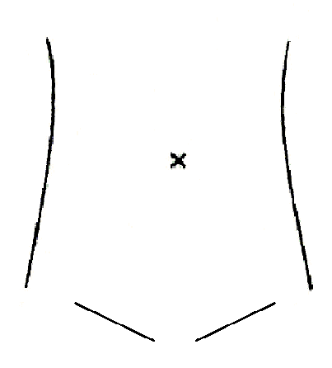
Steps for IUS examination – examining large bowel
BACK
STEP 4
The large bowel scan starts with sweeping back and forth in the transverse direction for an overview of the pathology while tracing the path of the sigmoid colon
(shown as blue circle in the image on left).¹
Click the bulb icon to know more
Photo kindly provided by A/Prof. Jun Miyoshi, Kyorin University School of Medicine, Japan
IUS: intestinal ultrasound
1. Nylund, K. (2017). Ultraschall in der Medizin (Stuttgart, Germany : 1980), 38(3), e1–e15.
Notes:
1. Nylund, K., Maconi, G., Hollerweger, A., Ripolles, T., Pallotta, N., Higginson, A., Serra, C., Dietrich, C. F., Sporea, I., Saftoiu, A., Dirks, K., Hausken, T., Calabrese, E., Romanini, L., Maaser, C., Nuernberg, D., & Gilja, O. H. (2017). EFSUMB Recommendations and Guidelines for Gastrointestinal Ultrasound. EFSUMB-Empfehlungen und Leitlinien des Gastrointestinalen Ultraschalls - Teil 1: Untersuchungstechniken und Normalbefund (Langversion). Ultraschall in der Medizin (Stuttgart, Germany : 1980), 38(3), e1–e15. https://doi.org/10.1055/s-0042-115853
2. Atkinson, N., Bryant, R. V., Dong, Y., Maaser, C., Kucharzik, T., Maconi, G., Asthana, A. K., Blaivas, M., Goudie, A., Gilja, O. H., Nuernberg, D., Schreiber-Dietrich, D., & Dietrich, C. F. (2017). How to perform gastrointestinal ultrasound: Anatomy and normal findings. World journal of gastroenterology, 23(38), 6931–6941. https://doi.org/10.3748/wjg.v23.i38.6931

Slide 13
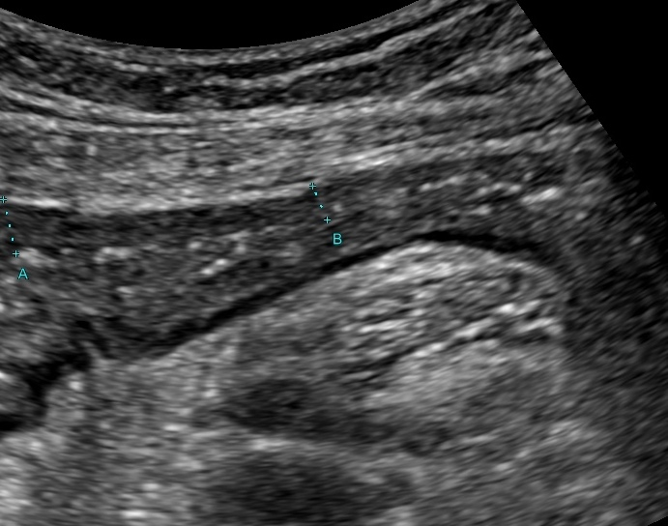
Identifying sigmoid colon as the first step for examining large bowel on IUS
BACK
Sigmoid colon
Iliopsoas muscle
Sigmoid colon can be identified as the first loop of the bowel crossing the left iliac blood vessels, which is then followed up to the descending colon.²
The iliopsoas muscle can be used as a landmark for the identification of sigmoid colonic segments in the left iliac fossae.²
Iliac Artery & Vein
Click to play the Video
Photo kindly provided by A/Prof. Jun Miyoshi, Kyorin University School of Medicine, Japan
IUS: intestinal ultrasound
1. Nylund, K. (2017). Ultraschall in der Medizin (Stuttgart, Germany : 1980), 38(3), e1–e15. 2. Atkinson, N. (2017). World journal of gastroenterology, 23(38), 6931–6941.
Notes:
1. Nylund, K., Maconi, G., Hollerweger, A., Ripolles, T., Pallotta, N., Higginson, A., Serra, C., Dietrich, C. F., Sporea, I., Saftoiu, A., Dirks, K., Hausken, T., Calabrese, E., Romanini, L., Maaser, C., Nuernberg, D., & Gilja, O. H. (2017). EFSUMB Recommendations and Guidelines for Gastrointestinal Ultrasound. EFSUMB-Empfehlungen und Leitlinien des Gastrointestinalen Ultraschalls - Teil 1: Untersuchungstechniken und Normalbefund (Langversion). Ultraschall in der Medizin (Stuttgart, Germany : 1980), 38(3), e1–e15. https://doi.org/10.1055/s-0042-115853
2. Atkinson, N., Bryant, R. V., Dong, Y., Maaser, C., Kucharzik, T., Maconi, G., Asthana, A. K., Blaivas, M., Goudie, A., Gilja, O. H., Nuernberg, D., Schreiber-Dietrich, D., & Dietrich, C. F. (2017). How to perform gastrointestinal ultrasound: Anatomy and normal findings. World journal of gastroenterology, 23(38), 6931–6941. https://doi.org/10.3748/wjg.v23.i38.6931

Slide 14
VIDEO
Using a high-frequency transducer to trace the path of the sigmoid colon and measuring bowel wall thickness for various segments of the large bowel (in a healthy individual)
BACK
Video kindly provided by Dr. Shintaro Sagami, Kitasato University Kitasato Institute Hospital, Japan

Slide 15
Steps for IUS examination – examining small bowel
BACK
The IUS technique for examining the small intestine is known as “mowing the lawn” or “lawnmower technique”¹
STEP 5
The small intestine at the upper left abdomen is often the jejunum
The small bowel scan starts by returning the probe to the right iliac fossa and identifying the terminal ileum.²
Find the ileocecal valve and trace back to the terminal ileum.
NOTE: It is often difficult to observe ileum behind of the pelvic bone
The iliopsoas muscle can be used as a landmark for the identification of the terminal ileum in the right iliac fossae.³
Starting in the RLQ and using graded compression, abdominal quadrants are slowly scanned as depicted in the image on left.¹
Photo kindly provided by A/Prof. Jun Miyoshi, Kyorin University School of Medicine, Japan
IUS: intestinal ultrasound
1. Dinh V. Abdominal Ultrasound Made Easy: Step-By-Step Guide. Available at: https://www.pocus101.com/abdominal-ultrasound-made-easy-step-by-step-guide/. 2. Nylund, K. (2017). Ultraschall in der Medizin (Stuttgart, Germany : 1980), 38(3), e1–e15. 3. Atkinson, N. (2017). World journal of gastroenterology, 23(38), 6931–6941

